Slide 1

Make Agentic Data Trust real.
Agentic AI Solutions
for Data Trust #05:
Data Lineage Stitching Agent
Specifications
Capgemini Insights & Data,
December 2025

Slide 2
Problem statement
Most Data Catalog tools can parse lineage within a single system (e.g., inside Snowflake or inside Power BI). But when data moves across systems—say from an S3 bucket → Spark job → Snowflake table → BI dashboard—those tools struggle to connect the dots. The result? You get isolated lineage chains instead of a complete end-to-end view.
The Agent should be able to...
...collect lineage fragments from various sources
...normalize and understand context and similarities between systems
...stitch the fragments from across systems into a unified graph
...generate a visual map via a cross-system lineage diagram
...validate maps with SMEs and publish them to the Catalog

Slide 3
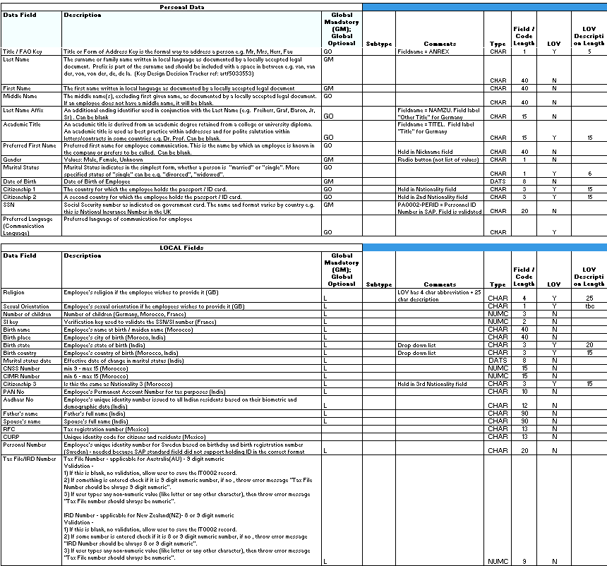
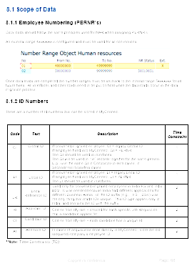

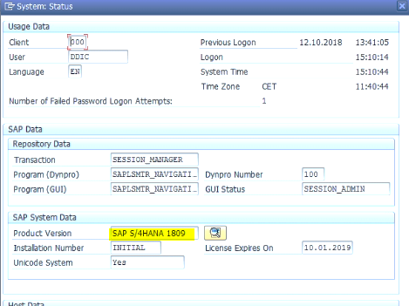
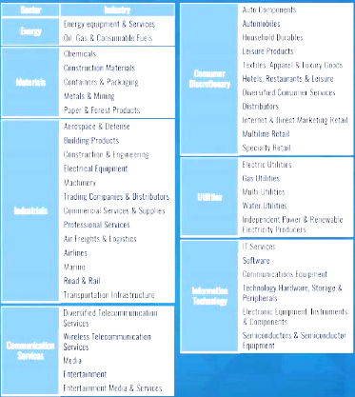
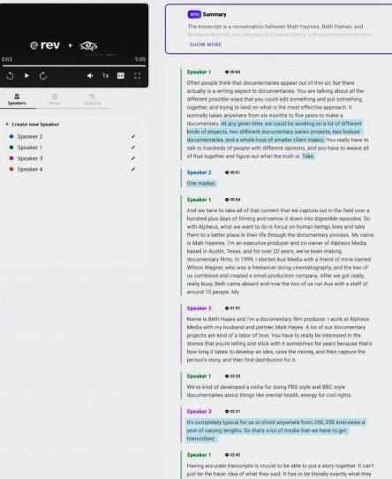
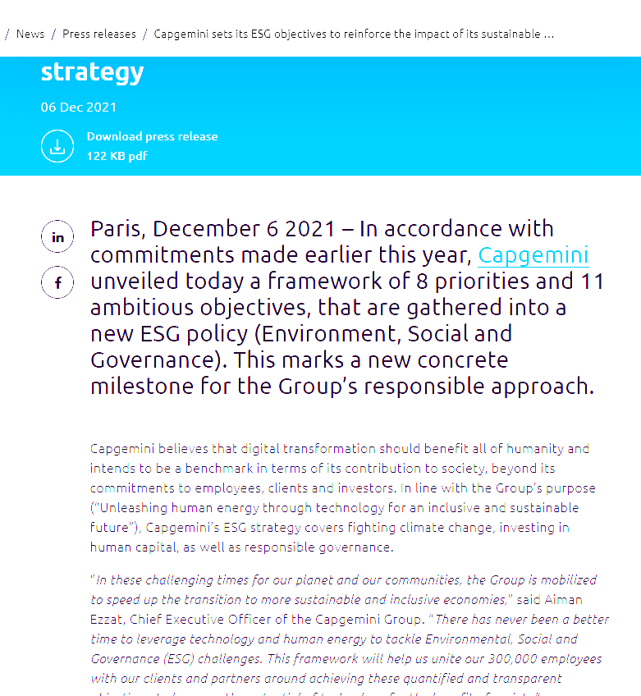
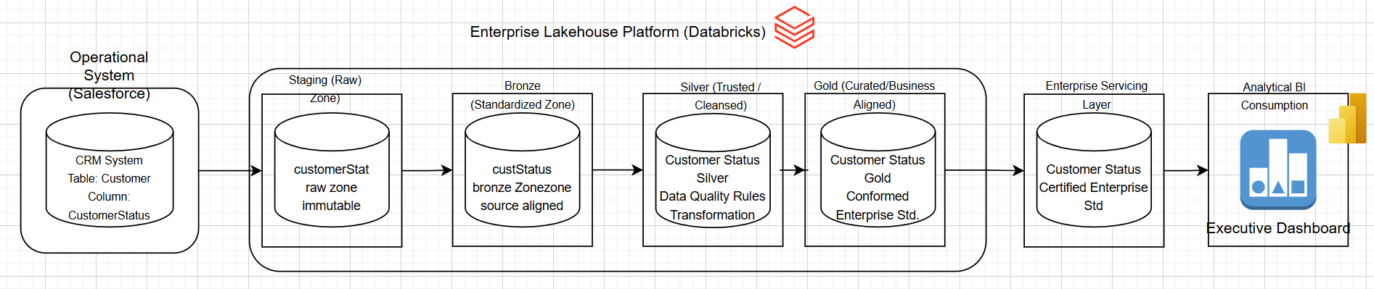
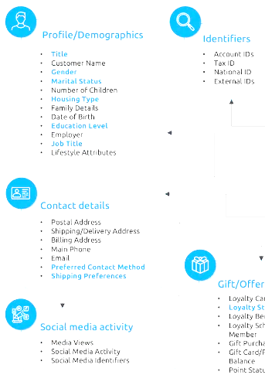



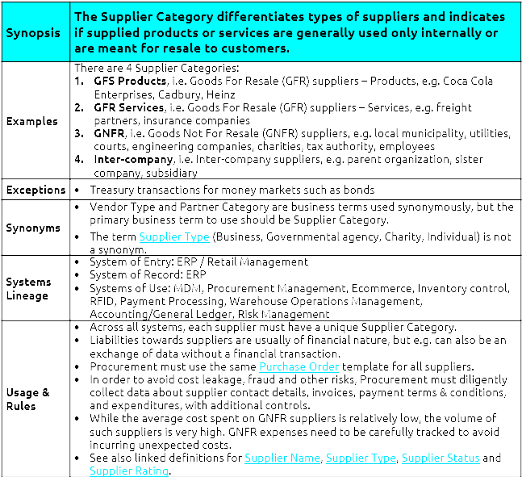

Capgemini’s Agentic End-to-End Data Lineage Stitching
The corporate LLM loaded with authoritative enterprise documentation enables 5 AI Agents:
Agent 1: Parse
Agent 2: Draft
Agent 3: Gap analysis
Agent 4: Final draft
Agent 5: Load to Data Catalog
Interface Control Documents
Business Glossary
Video recordings of
XXX
Data Dictionaries
SME interviews
Sample end-to-end data lineage
for Customer Status data
Confluence / Slack
Data Models
Data Policies

Slide 4
High-level steps to be performed by “Data Lineage Stitching Agent” (1/2)
Overall AI Agent objective: Enable a human‑in‑the‑loop AI agent to extract, complete, and stitch end‑to‑end data lineage and source‑to‑target mappings across multiple systems, producing validated mappings and clear visuals that can be published to the catalog—with confidence scores, audit trail, and SME approvals.
DG Team defines what constitutes valid lineage mapping
  Clarify rules for source-to-target relationships, transformation logic, and confidence scoring
  Document standards for system IDs, dataset IDs, and column naming conventions
DG Team trains the LLM on dozens of high-quality, best-practice lineage examples, including:
  Source and target mappings
  Transformation expressions
  Synonyms and naming variations
  Business context and domain ownership
  Common exceptions and ambiguous cases
DG Team sources authoritative artifacts from SMEs
  Collect SQL scripts, ETL configs, BI definitions, data contracts, and process documentation
  Load these into the LLM as reference material for retrieval or fine-tuning
DG Team gets AI Agent 1 to parse lineage fragments from authoritative sources
  Extract source tables, target tables, and transformation logic
  Validate parsed fragments with SMEs for accuracy
DG Team interviews SMEs to capture domain-specific lineage knowledge
  Document expertise (who knows which systems and flows).
  Feed transcripts into the LLM for contextual understanding
DG Team gets AI Agent 2 to create first-draft lineage mappings
  Combine parsed fragments with authoritative metadata.
  Ensure at least 50% coverage of source-target relationships
7. DG Team gets AI Agent 3 to identify missing elements in mappings
  Highlight gaps such as unknown transformations, missing source fields, or unclear joins
8. DG Team gets AI Agent 3 to query SMEs about missing lineage details
  Generate structured questions and friendly follow-ups for clarification

Slide 5
High-level steps to be performed by “Data Lineage Stitching Agent” (2/2)
Overall AI Agent objective: Enable a human‑in‑the‑loop AI agent to extract, complete, and stitch end‑to‑end data lineage and source‑to‑target mappings across multiple systems, producing validated mappings and clear visuals that can be published to the catalog—with confidence scores, audit trail, and SME approvals.
DG Team gets AI Agent 4 to incorporate SME feedback and finalizes mappings
  Complete mappings to 100% coverage with confidence scores and assumptions documented
10. DG Team gets AI Agent 4 to stitch mappings into an end-to-end lineage graph
  Connect fragments across systems into a unified view
  Validate graph completeness and resolve conflicts
11. DG Team gets AI Agent 4 to generate visual representations
  Produce diagrams linked to mapping data
12. DG Team gets AI Agent 5 to load finalized lineage into the Data Catalog
  Link lineage with other metadata assets (data contracts, quality rules, domains)
13. DG Team agrees approvals workflows and agrees them with client SMEs
  Agree workflows and load into LLM
  Get LLM to request approvals
14. DG Team uses feedback to iteratively improve prompts, examples, and the LLM’s performance.
  Measure and improve
  Track time/effort savings (A/B testing)
15. Change Control & Operationalization
  CG team embeds lineage updates into BAU processes
  Monthly reports
  Regular testing

Slide 6
How the Agents stitch lineage across systems
Imagine your organization’s data flowing through many systems—databases, ETL tools, data warehouses, and BI dashboards. Each system knows its own piece of the puzzle, but no one sees the full picture. This Agentic solution acts like a smart coordinator that connects those pieces into a clear, end-to-end map.
How it works in plain language:
Reads the instructions: The agent looks at your existing documentation—SQL scripts, ETL job configs, BI reports—and understands how data moves from one place to another.
Builds small pieces first: It creates mini-maps showing which tables and columns feed into others, including any transformations (like “uppercase names” or “calculate totals”).
Connects the dots: It links these mini-maps together across systems, so you can trace a data point from its original source all the way to the final report.
Checks with experts: If something is unclear (e.g., a column name mismatch), the agent asks your subject matter experts for clarification.
Draws the big picture: Finally, it produces a visual diagram and a structured mapping file that everyone can understand and trust, and loads them into the Data Catalog.

Slide 7
Agents Overview
Agent | Description | Purpose | Key Inputs | Key Output
A1 | Lineage Parser | Extract technical lineage fragments from raw artifacts into a strict, reviewable JSON structure with provenance and confidence scoring. | SQL/ETL/BI artifacts + file paths/line numbers Ontology & mapping schema, synonyms, rename history | Fragments JSON: sources, targets, transforms, confidence, issues, citations
A2 | Mapping Synthesizer & Gap Detector | Turn multiple fragments and reference materials into first‑draft source→target mappings and explicit gap lists to accelerate SME review. | Agent 1 fragments; data contracts; SLAs; ontology & policies | Mapping JSON (draft) with assumptions and confidence Gap pack: prioritized questions and open issues
A3 | SME Orchestrator & Finalizer | Coordinate SME interactions to close gaps, then apply clarifications to produce final, policy‑compliant mappings with updated confidence. | Gap pack & draft mappings (Agent 2) SME registry; interview transcripts; exception policies | Final mapping JSON (100% mapped or justified) Acceptance checklist; residual risk notes; audit trail of Q&A
A4 | Lineage Stitcher & Visualizer | Connect validated mappings into end‑to‑end lineage across systems and generate readable visuals for validation and communication. | Final mappings (Agent 3); stitching rules; rename concordance | Stitched graph JSON (nodes/edges with confidence & issues) Visual exports ready for steward/executive review
A5 | Publisher & Catalog Linker | Publish approved lineage to your catalog (and adjacent governance tools) and cross‑link with owners, policies, data contracts, DQ rules, and access groups. | Approved stitched graph (Agent 4) + mapping JSON Catalog object model, policies, and release conventions | Catalog entries with lineage and governance links Release bundle: changelog, approvals, known gaps, rollback notes

Slide 8
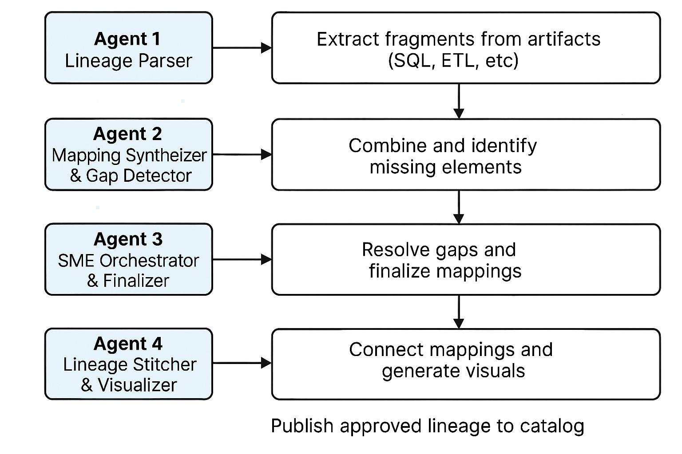
Agent Triggers
Agent 1 is triggered whenever new/changed artifacts land (SQL/ETL/BI).
Agent 2 runs after parsing to compile drafts and identify gaps.
Agent 3 engages once gaps exist; it manages SME clarification and finalization.
Agent 4 runs post‑approval of mappings to stitch and visualize the full path.
Agent 5 publishes the approved state to the catalog and maintains release hygiene.
Agent 5

Slide 9
Feedback on the script in this deck from Vikas Singh (I&D FS NA)
[I would propose] splitting the design into two buckets: the lineage piece itself, and the agent architecture underneath.
On the lineage side:
The biggest opportunity I see is leaning on deterministic parsers before bringing the LLM into the picture. SQL scripts, ETL configs, dbt manifests all have well-defined structure. Something like sqlglot can give you column-level lineage with zero hallucination risk. The LLM should really only handle the stuff parsers can't: unstructured docs, ambiguous transformations, cross-system name matching. That one shift alone would improve reliability quite a bit.
The other thing that jumped out is lineage decay. Schemas change, ETL logic gets updated, BI models get rebuilt. The deck mentions change control and monthly reports, but I didn't see a mechanism for automatically catching when upstream artifacts have changed and the lineage is going stale. Without that, the team could end up in a maintenance loop that wasn't scoped for.
On confidence scoring, I would suggest for separating by evidence type. A mapping from a direct SQL parse is a very different quality level than one inferred from column-name similarity. Lumping them into a single 0 to 1 score makes it hard for anyone (especially regulators in FS) to judge what they can trust.
Also, 50% automated first-draft coverage feels low. If half the mappings still need SME involvement, the story starts to look more like "LLM-assisted manual lineage" than an automated solution. I think 70 to 80% is achievable if the retrieval and grounding layer is solid, and that's where the ROI case gets much stronger.
Last thing on this side: the SME model works for a pilot, but individual 30 to 45 minute interviews won't hold up across hundreds of pipelines. Batch reviews, async approvals with timeouts, and a knowledge base that remembers past SME answers would go a long way.
On the agent architecture:
Architecturally, in my understanding of agents, the five components today are closer to prompt templates run in sequence than to AI agents.
The missing pieces are things like autonomous planning, dynamic tool use, reflection loops, and error recovery.
That doesn't mean the approach isn't useful. It absolutely is. But framing it as "agentic" sets expectations around autonomy and resilience that the current design doesn't deliver on yet. Worth discussing whether to adopt a proper agent framework or position this honestly as an LLM-powered workflow.
A retrieval layer (RAG) is probably the single highest-impact investment. Right now every step loads artifacts into the LLM context directly, and that just won't scale when you're dealing with thousands of SQL scripts and hundreds of ETL configs. A vector store with semantic search would let each step pull only what it needs.
I'd also strongly recommend adding a reflection step after each agent's output. Right now the pipeline is linear, so if Agent 1 produces something off, nothing catches it before Agent 2 tries to work with it. A quick generate, critique, refine cycle at each stage prevents errors from snowballing.
And on the hallucination front, spot-checking 10% plus self-reported confidence won't be enough for FS clients. Requiring verifiable citations (file path, line number) for every mapping, with an independent check that the citation actually supports the claim, would be much stronger.
Lastly, there's no tracing of how the agents arrive at their decisions, and no structured error handling if a step fails. For regulated environments, you need both.
The hard part of this work is the domain understanding and the process design, and that's clearly solid. These are architectural things that can be layered in.

Slide 10
Step 1: Define “Valid Lineage Mapping” & Standards
Motivation: Consistency beats cleverness. Clear rules remove ambiguity, reduce rework, and make outputs auditable.
Capgemini team agrees with client SMEs on scope, objectives, definitions, technology and baseline rules and loads them into the LLM. This instructs the AI Agents in rules they must follow for lineage parsing, mapping, confidence scoring, and approvals.
CG team and client SMEs assign a trust level (1–10) and priority (A–E) to each standard and policy artifact:
  Scope & Granularity --> Decide domains, systems, and level (table vs. column) for phase 1. Criteria: regulatory exposure, incident history, dependency breadth.
  Ontology & IDs --> Freeze canonical ID patterns; Define relationships: reads, writes, derives_from, transforms, publishes
  Mapping Contract (Output Schema) --> Lock a JSON/Excel schema with mandatory fields (sources, target, transforms, confidence, assumptions, issues, owner). Add acceptance checks (e.g., “every target field must have ≥1 source or an issue entry”).
  Confidence & Review Policy --> 0.9–1.0 = explicit; 0.7–0.89 = inferred with evidence; <0.7 = needs_review.; Define which client stakeholders sign off when confidence <0.9.
CG team loads into the LLM:
  lineage ontology (entities, relationships), naming conventions, canonical ID patterns
  acceptance criteria (mandatory mapping fields, evidence rules, audit requirements)
  confidence thresholds and review/escalation policy
  examples of compliant vs. non‑compliant mappings
CG team tests if LLM has ‘absorbed’ these standards, can validate a sample mapping against the policy and flag violations.

Slide 11
Step 2: Curate High‑Quality Training Examples (Gold Set)
Motivation: The agent learns by analogy. Exemplars determine quality, not model size.
CG team prepares dozens of best‑practice lineage exemplars covering varied patterns; each case labeled with trust (1–10) and priority (A–E). Include: source and target mappings, transformation expressions, synonyms, naming variations, business context, domain ownership, exceptions, and ambiguous cases.
  Select representative patterns --> include CTAS (CREATE TABLE AS SELECT), views, multi-joins with renames, SCD (Slowly Changing Dimensions), dbt refs, BI semantic mapping, UDFs (User-Defined Functions)
  Author Gold label --> assign expected mapping and stitching graph for each artifact with annotation (renames, assumptions, edge cases)
  Diversity and difficulty --> add negative examples (ambiguity, missing qualifiers); cloud vs on-prem; SQL dialects and ETL/ELT tools
  Version & traceability --> store with source path and commit hash; tag sets with versioning and change log
CG team loads into the LLM:
  CTAS/view examples (simple, pass‑through, nested CTEs)
  Multi‑join with renames, aggregations, filters, window functions
  SCD MERGE patterns, incremental loads, CDC examples (Change Data Capture)
  dbt ref()/source() models and macros
  BI semantic → SQL lineage cases (Power BI/Tableau)
  negative/tricky examples (SELECT *, ambiguous names)
CG team tests if LLM can produce the expected mapping JSON and stitched edges for each exemplar and explain its confidence.

Slide 12
Step 3: Authoritative Artifacts (Grounding Corpus)
Motivation: Retrieval beats recall. Grounding minimizes hallucinations and anchors outputs in truth.
CG team sources authoritative artifacts from client SMEs:
  Collect Sources --> SQL scripts, stored procedures, dbt models, ETL configs (Airflow/Talend/Informatica), BI models (PBI/Tableau), data contracts, SOPs.
  Normalize & Sanitize --> Standardize folder structure; remove secrets; mask PII per policy. Capture metadata: owner, domain, environment, last change.
  Create Synonym & Rename Dictionary --> historical renames, and domain‑specific aliases.
  Provenance Index -->Keep file paths + line numbers; this will feed citations/audit trails in outputs.
CG team loads into the LLM:
  SQL scripts and stored procedures from critical systems
  ETL/ELT configs (Airflow, Informatica, Talend, Spark)
  dbt models (SQL + YAML), seeds, snapshots
  BI metadata (Power BI datasets, Tableau workbooks)
  data contracts, SLAs, SOPs, and domain charters
  company taxonomy/ontology and industry specs (e.g., OpenLineage)
  local glossaries/data dictionaries per system
  data models (ERDs), interface specs, and job runbooks
  relevant SME emails and process notes
CG team tests if LLM can extract source→target mappings, transformation expressions, owners, and propose stitches across systems with citations.

Slide 13
Step 4: Agent 1 — Parse Lineage Fragments from Artifacts
Motivation: Break big problems into safe pieces. Parsing yields verifiable fragments before any stitching.
CG team instructs Agent 1 to parse code/configs into strict fragment JSON with confidence and issues; trust and priority derived from artifact provenance:
  Run Parsing Prompt --> Feed artifact + synonyms + canonical IDs; request strict JSON fragments with confidence scores.
  Quality Gates --> Auto‑reject fragments missing mandatory fields; flag SELECT * without expansion; Require explicit issues for ambiguous cases.
  Human Validation (Spot Check) --> SMEs review low‑confidence (<0.7) and random 10% of high‑confidence for calibration; Corrections become new few‑shot examples.
CG team:
  Run with the LLM: parsing prompts that enforce the output schema and ontology
  Provide to the LLM: canonical IDs and synonym dictionaries for normalization
  Provide to the LLM: file paths and line numbers for provenance citations
  Capture from the LLM: fragments with sources, targets, transforms, confidence, and issues
CG team tests if Agent 1 flags SELECT * cases, ambiguous joins, and unresolved UDFs

Slide 14
Step 5: Capture SME Knowledge & Ownership Registry
Motivation: The agent learns by analogy. Exemplars determine quality, not model size.
CG team interviews SMEs to convert tacit lineage knowledge into structured guidance; assign trust (1–10) to each transcript and priority (A–E) per domain:
CG team
  Conducts targeted SME interviews: 30-45 min per SME focused on specific flows; record and transcribe. Standard guide: systems owned, common transforms, known exceptions, rename history.
  Extracts FAQs & rules: Turn transcripts into Q&A snippets, heuristics, and “gotchas”. Add to the context library of Agent 1.
  Builds ownership registry: Map SMEs to datasets/jobs for future auto‑routing of questions.
CG team loads into the LLM:
  Interview transcripts and summaries (systems owned, typical transforms, rename history)
  SME expertise matrix (who knows what; coverage map)
  FAQ snippets, known exceptions, “gotchas” for edge cases
CG team tests if LLM can route questions to the correct SME and surface relevant prior answers automatically.

Slide 15
Step 6: Agent 2 — Produce First‑Draft Mappings
Motivation: Faster to edit than to author. Give stewards something concrete to react to.
CG team directs Agent 2 to synthesize parsed fragments + authoritative sources into first‑draft mappings (≥50% coverage), tagged with confidence and assumptions:
CG team
  Synthesize Drafts: Merge parsed fragments + contracts + SME rules into a single mapping per target.
  Coverage Target: Aim for ≥50% of target fields mapped with explicit sources & transforms. Mark gaps with issues and candidate sources.
  Score & Tag: Compute confidence; tag needs_review where thresholds aren’t met.
CG team loads into the LLM:
  fragments from Step 4 and policies from Step 1
  relevant contracts/SLAs for impacted datasets
CG team captures from the LLM:
  mapping JSON per target with transforms and citations
  explicit issues list and assumptions for gaps
CG team tests if Agent 2 meets minimum coverage, adheres to canonical IDs, and assigns appropriate confidence levels.

Slide 16
Step 7: Agent 3 — Identify Missing Elements & Generate Questions
Motivation: Make unknowns explicit. Clear gaps, reduce back‑and‑forth and speed approvals.
CG team tasks Agent 3 to detect gaps and produce precise SME questions; prioritize by business impact (A–E):
CG team
  Gap Detector: Find unmapped fields, unclear joins/filters, opaque UDFs, or layered views.
  Generate Questions: For each gap, propose specific, non‑leading questions referencing file lines and business context.
  Route to Right SME: Use the ownership registry to assign queries; group related questions to limit noise.
CG team loads into the LLM: gap detection rules (unmapped fields, unclear joins, opaque UDFs)
CG team capture from the LLM:
  structured question sets referencing exact files/lines and business context
  ranked list of gaps by criticality and suggested evidence to collect
CG team tests if LLM’s question pack reduces SME back‑and‑forth and resolves >70% of gaps in one pass.

Slide 17
Step 8: Agent 3 — Orchestrate SME Q&A and Follow‑ups
Motivation: Structured follow‑ups turn “tribal” knowledge into reusable metadata.
CG team enables Agent 3 to contact the right SMEs with context, collect answers, and consolidate conflicting inputs; apply trust weighting by SME/source (1–10)
CG team
  Outbound Requests: Send SMEs concise, context‑rich questions with friendly SLAs and one‑click approve/annotate links.
  Chase & Consolidate: Send SMEs gentle reminders; consolidate conflicting answers and highlight discrepancies.
  Normalize Responses: Convert SMEs’ replies into transform expressions, source references, or documented exceptions.
CG team provides the LLM with SME registry and communication templates
CG team capture from the LLM:
  outbound messages with citations and clear due dates
  normalized responses (transform rules, source references, exceptions)
CG team tests if Agent 3 captures answers in structured form and resolves conflicts or escalates with rationale.

Slide 18
Step 9: Agent 4 — Finalize Mappings to 100%
Motivation: Ship a complete, review‑ready artifact with audit trail.
CG team instructs Agent 4 to apply SME input, complete mappings, re‑score confidence, and prepare review‑ready artifacts:
CG team
  Apply SME Input: Fill unmapped fields; update transforms; attach assumptions and issue resolutions.
  Re‑score Confidence: Upgrade entries supported by explicit evidence; leave contentious ones as needs_review.
  Steward Pre‑check: Run the acceptance checklist (completeness, IDs, DQ/PII tags, owners present).
CG team provides the LLM with consolidated Q&A outcomes and unresolved exceptions
CG team capture from the LLM:
  final mapping JSON with closed gaps and updated confidence
  acceptance checklist results and flagged residual risks
CG team tests if final mappings meet completeness criteria (every target field mapped or justified) and pass policy checks.

Slide 19
Step 10: Agent 4 — Stitch End‑to‑End Lineage Across Systems
Motivation: Business value lives in the path, not the node. Stitching reveals dependency chains.
CG team tasks Agent 4 to connect mappings into paths using deterministic rules first, then controlled heuristics; assign confidence per edge:
CG team
  Deterministic Matching First: Join on canonical IDs, explicit refs (e.g., dbt ref, job outputs). Apply synonyms and known rename rules only if deterministic links fail.
  Conflict Handling: Flag over‑stitches (multiple possible sources) and under‑stitches (islands). Provide proposed fixes and confidence for each edge.
  Completeness Checks: Ensure start (ingest) and end (consumption) nodes exist for critical paths; list gaps.
CG team loads into the LLM:
  stitching precedence (contracts/ref() → qualified names → synonyms → fuzzy)
  rename history and cross‑system ID concordance
CG team captures from the LLM:
  stitched nodes/edges with confidence and conflict notes
  list of islands (unstitched fragments) with proposed fixes
CG team tests if stitched paths correctly traverse ingest → staging → marts → BI for priority domains.

Slide 20
Step 11: Agent 4 — Generate Visuals for Validation & Communication
Motivation: Visuals accelerate validation and executive understanding.
CG team directs Agent 4 to render readable visuals and link them back to mappings and sources:
CG team
    Produce Multiple Diagram Formats:
      Mermaid (docs), Graphviz DOT (dev), and Draw.io / Eraser.
      Ensure node labels show owner, domain, sensitivity, and confidence.
    Layout & Readability
      Group by domain/layer (ingest → staging → marts → BI).
      Collapse noisy edges; allow drill‑down for column‑level detail.
    Link‑Backs
      Each node/edge links to the mapping JSON row and source artifact line numbers.
CG team captures from the LLM: Mermaid and Graphviz DOT exports for documentation/engineering
  Mermaid and Graphviz DOT exports for documentation/engineering
  Draw.io / Eraser exports aligned to team tools
  labels including owner, domain, sensitivity, and confidence; links to source lines
CG team tests if visuals are navigable, grouped by layers/domains, and support drill‑down to column level where needed.

Slide 21
Step 12: Agent 5 — Publish to the Catalog & Cross‑Link Assets
Motivation: Make lineage actionable. Put it where people discover and govern data.
CG team authorizes Agent 5 to load approved lineage artifacts into the catalog and link to governance metadata; apply trust annotations and version tags:
    Catalog Load (Manual‑first if needed): Post approved mappings and graphs; attach business glossary, contracts, and DQ rules.
    Cross‑Linking: Connect datasets to owners, policies, SLAs, access groups, and quality monitors.
    Release Management: Version artifacts (e.g., lineage-customer-2025-10-30); store changelog and approvals.
CG team loads into the LLM: catalog object models and publishing conventions
CG team captures from the LLM:
    catalog entries for datasets/jobs with lineage graphs attached
    cross‑links to owners, policies, SLAs, access groups, and DQ rules
CG team tests if published assets appear in catalog search with lineage, ownership, and policy links intact.

Slide 22
Step 13: Approvals & Governance Sign‑off
Motivation: Trust is formalized through accountable approval.
CG team runs an approval workflow where SMEs/Owners sign off; threshold‑based acceptance (e.g., ≥50% SME approvals or explicit Owner sign‑off):
  SME & Owner Approval Workflow: Threshold policy (e.g., ≥50% SMEs respond or explicit Owner sign‑off). Capture digital signatures or approvals in ticketing system.
  Exception Register: Track known black boxes and accepted risks with review dates.
  Audit Pack: Bundle mappings, visuals, provenance, and approval evidence for compliance.
CG team loads into the LLM: approval matrix (RACI), thresholds, and escalation policy
CG team captures from the LLM:
  approval requests with concise diffs and impact notes
  approval ledger (who approved what, when, and why)
CG team tests if approvals meet thresholds and the audit trail is complete and exportable.

Slide 23
Step 14: Measure Value & Improve (A/B and KPIs)
Motivation: Demonstrate value, justify scaling, and target the next bottleneck.
CG team measures time/effort savings, precision/recall, and completeness; use results to refine prompts, rules, and examples:
  KPIs: Time to first draft, % needs_review, mapping precision/recall (spot audits), number of stitched end‑to‑end paths, and mean time to approve.
  A/B Testing: Compare manual‑only vs. agent‑assisted cycles on matched flows.
  Continuous Learning: Convert corrections into new few‑shot examples; update synonym dictionaries and rules. Quarterly refresh of gold set; retire stale patterns.
CG team loads into the LLM: KPI definitions (coverage, precision/recall, review rate, time‑to‑publish)
CG team captures from the LLM:
  run scorecards and comparisons vs. manual baseline (A/B)
  recommendations for new few‑shot examples and synonym updates
CG team tests if KPIs show statistically significant improvement and identify the top 3 levers for next iteration.

Slide 24
Step 15: Change Control & Operationalization
Motivation: Keep lineage living as systems evolve.
CG team embeds lineage updates into BAU processes (contracts, schema, ETL changes) and manages releases with clear versioning:
  Policy Hook: Require lineage updates for any data contract, schema, or ETL change before production deploy.
  Release Cadence: Monthly lineage releases for each domain; emergency hotfix lane for critical issues.
  Backlog & Roadmap: Track unresolved gaps, planned coverage expansion, and upcoming integrations.
CG team loads into the LLM:
  change policies tying lineage updates to deployment gates
  release cadence, tagging conventions, and rollback criteria
CG team captures from the LLM:
  monthly lineage release packs (artifacts, diffs, approvals, known gaps)
  backlog of unresolved items and planned domain expansions
CG team tests if changes to contracts/schemas trigger lineage refresh tasks before production deployment.

Slide 25
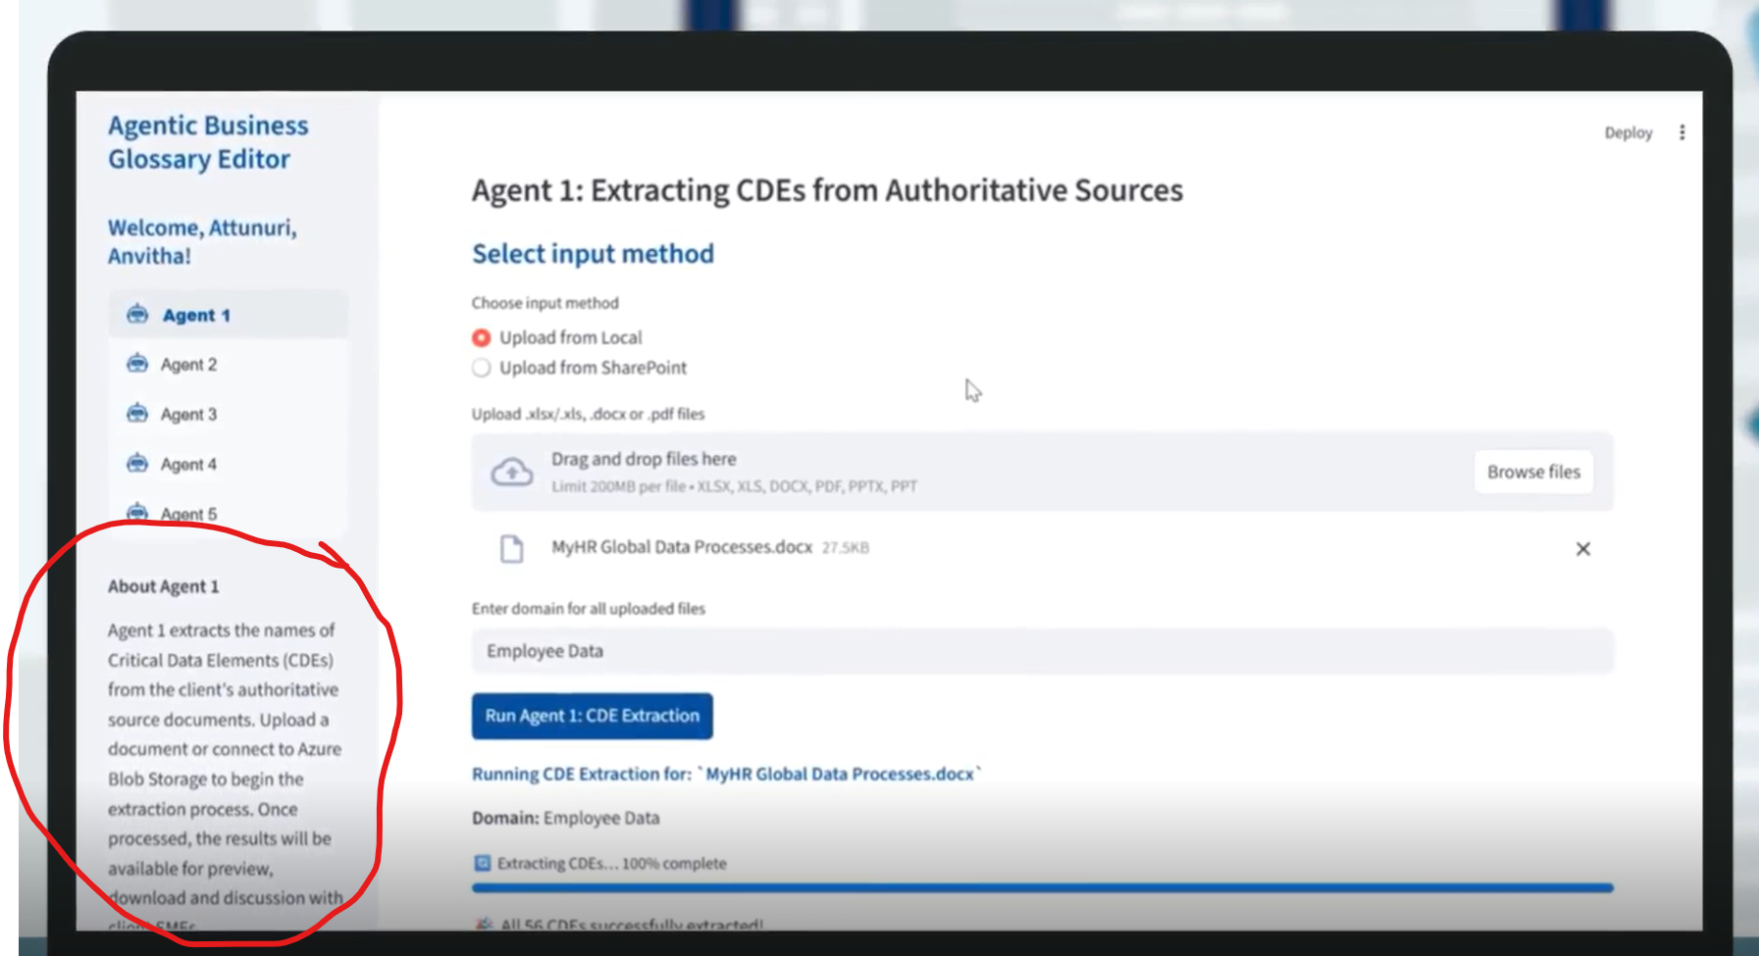
Descriptions of AI Agents for solution interface (“About Agent” blurb)
These blurbs of up to 50 words each will be shown in the left navigation pane of the tool interface below the page links, providing users with clarity on what each Agent is meant to achieve:
Knowledge Base:
This page allows users to: 1) agree the lineage project’s scope, objectives, definitions, technology and rules; 2) choose approaches to lineage parsing, mapping, confidence scoring and approvals; 3) load lineage ontology, acceptance criteria, confidence thresholds, mapping examples, technical specifications and SME expertise into the LLM. This forms the foundation for the AI Agents.
Agent 1:
Agent 1, the Lineage Parser, is triggered whenever new/changed artifacts land (SQL/ETL/BI). It extracts technical lineage fragments from raw artifacts into a strict, reviewable JSON structure with provenance and confidence scoring, and generates JSON elements such as sources, targets, transforms, confidence, issues, citations.
Agent 2:
Agent 2, the Mapping Synthesizer & Gap Detector, runs after parsing to compile drafts and identify gaps. It turns multiple fragments and reference materials into first‑draft source-to-target mappings and explicit gap lists to accelerate SME review. Outputs are draft mapping JSONs and gap packs.
Agent 3:
Agent 3, the SME Orchestrator & Finalizer, engages once gaps exist; it manages SME clarification and finalization. It coordinates SME interactions to close gaps, then applies clarifications to produce final, policy‑compliant JSON mappings with updated confidence, acceptance checklists, residual risk notes and an audit trail of the Q&A.
Agent 4:
Agent 4, the Lineage Stitcher & Visualizer, runs post‑approval of mappings to stitch and visualize the full path. It connects validated mappings into end‑to‑end lineage across systems and generates readable visuals for validation and communication. Visual exports are now ready for review by Data Stewards/Architecture SMEs.
Agent 5:
Agent 5, the Publisher & Catalog Linker, publishes the approved state to the Data Catalog and maintains release hygiene. It publishes approved lineage to the Catalog (and adjacent governance tools) and cross‑links with owners, policies, data contracts, DQ rules, and access groups. This release bundle also includes a change log, approvals, known gaps and rollback notes.

